Slide 1
Structure and Functional Biology
Second Week online Lecture (1/2)
Dr. Farrukh Jamil

Slide 2
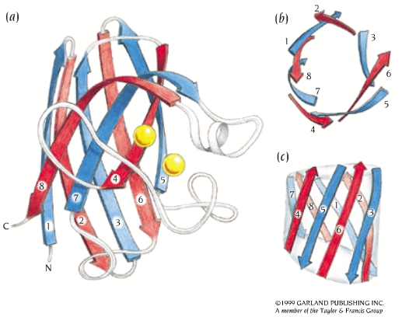

Beta Structures
Anti-parallel β strands are usually arranged in two β-sheets that pack against each other and form a distorted barrel structure, the core of the structure.
Depending on the way the β-strands around the barrel are connected along the polypeptide chain, they can be divided into four major groups:
Beta barrels
Up-and-down barrel
Greek Key barrel
Jelly roll barrel
superoxide dismutase (SOD)

Slide 3
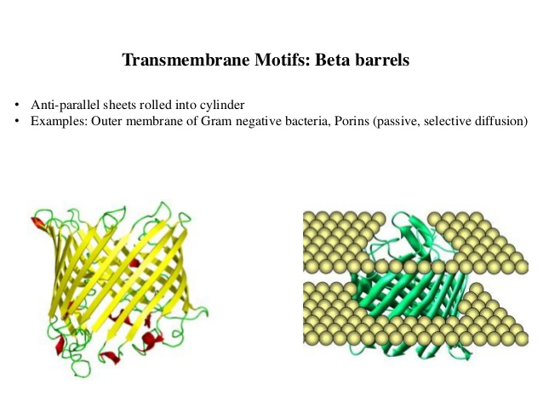
Beta Barrels

Slide 4
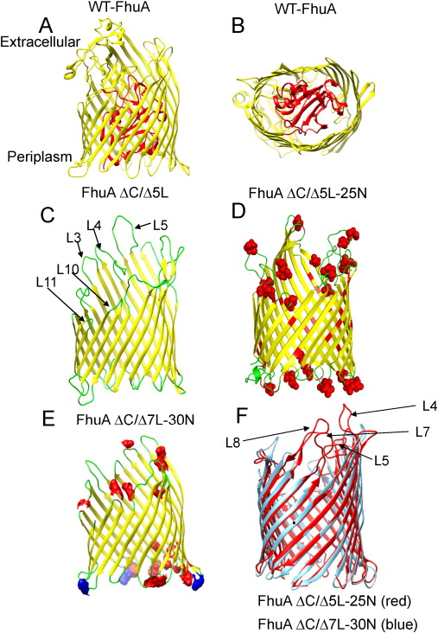

Slide 5
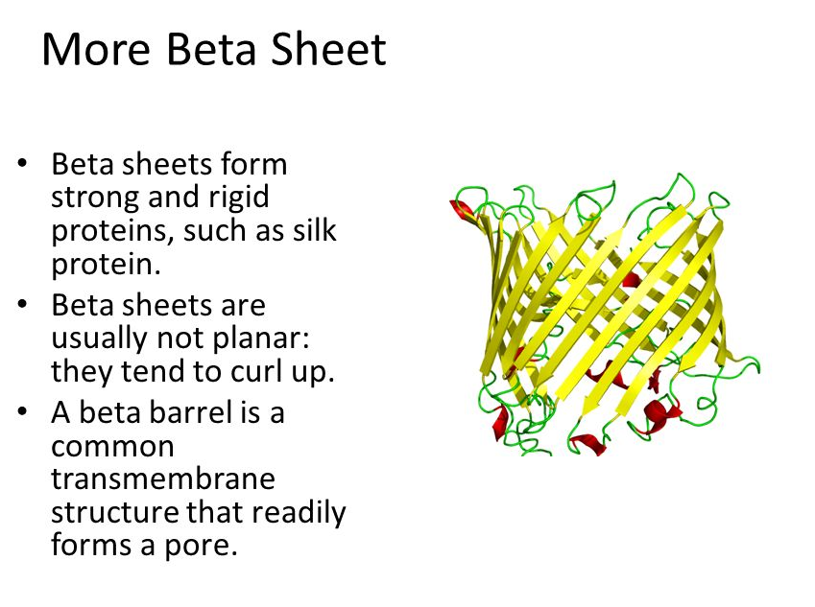

Slide 6
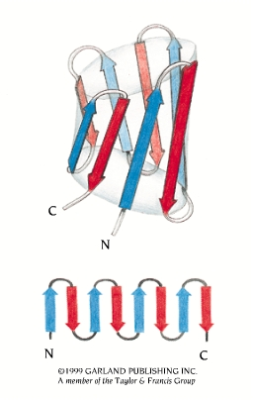
Up-and-down Barrel
Schematic and topological diagrams of an up-and-down β barrel.
The eight β strands are all antiparallel to each other and are connected by hairpin loops.
Beta strands that are adjacent in the amino acid sequence are also adjacent in the three-dimensional structure of up-and-down barrels.

Slide 7
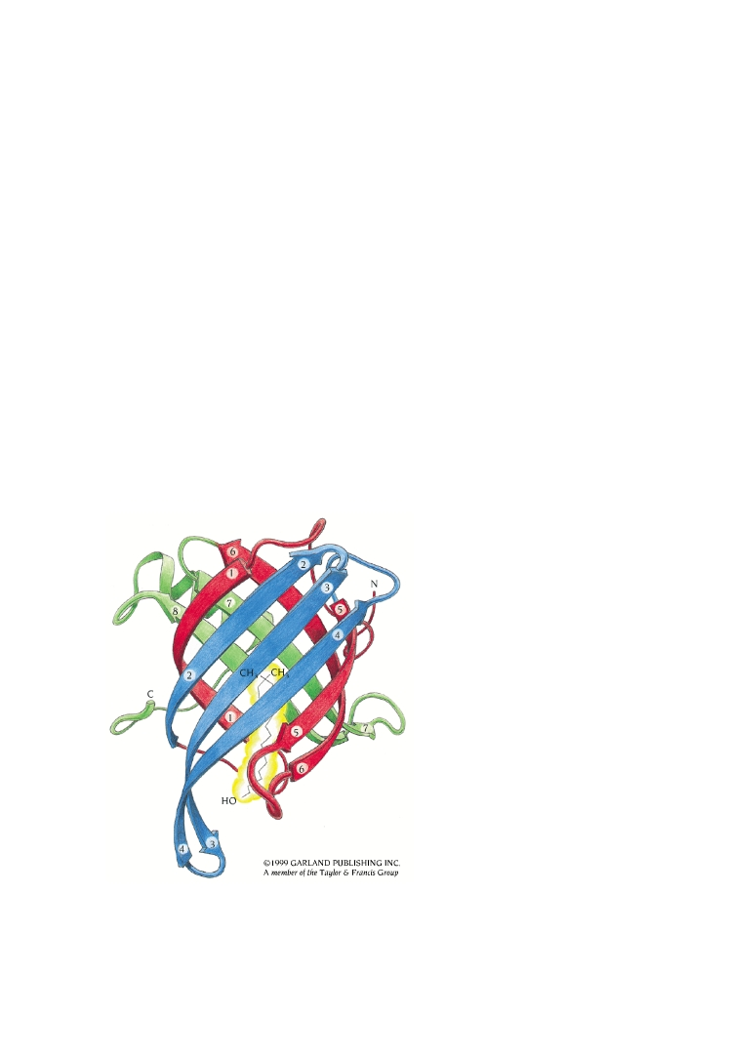
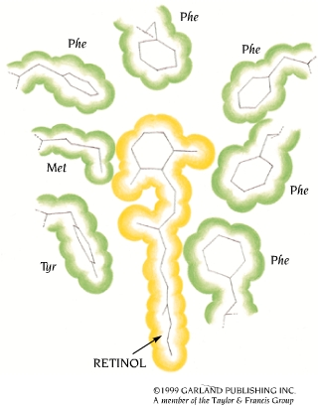
Retinol-binding Protein (RBP)
The structure of human plasma retinol-binding protein (RBP) is an up-and-down β barrel. A retinol molecule, vitamin A (yellow), is bound inside the barrel, between the two β sheets, such that its only hydrophilic part (an OH tail) is at the surface of the molecule.

Slide 8
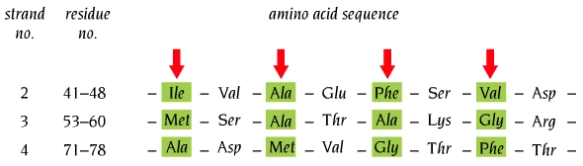
Amino Acid Sequence Reflects β Structure
Amino acid sequence of β strands 2, 3, and 4 in human plasma retinol-binding protein.
The sequences are listed in such a way that residues which point into the barrel are aligned.
These hydrophobic residues are shown by arrows and are colored green. The remaining residues are exposed to the solvent.

Slide 9
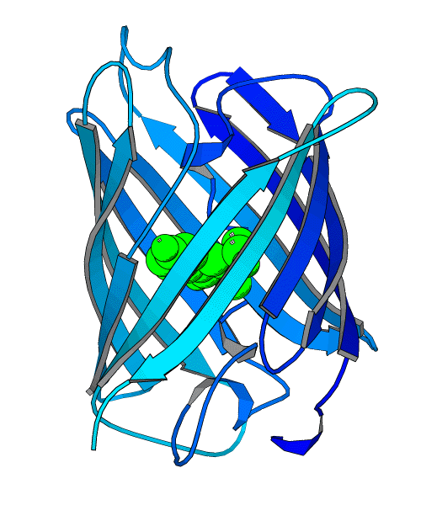
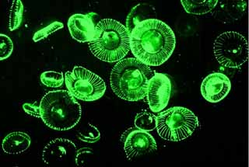
Green Fluorescent Protein
from Aequorea victoria (jellyfish)
11-stranded β-barrel
chromophore formed during folding (from residues S65, Y66, G67) is contained in the middle of the barrel
Excitation 395 nm and 475 nm
Emission 506 nm
http://www.plantsci.cam.ac.uk/Haseloff/GFP/GFPbackgrnd.html

Slide 10
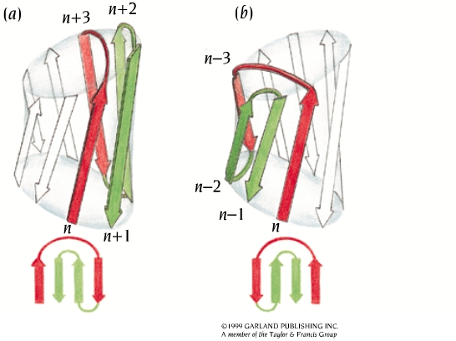
Greek Key Motifs
This motif is formed when one of the connections of four antiparallel β strands is not a hairpin connection.
The motif occurs when strand number n is connected to strand n + 3 (a) or n - 3 (b) instead of n + 1 or n - 1 in an eight-stranded antiparallel β sheet or barrel. The two different possible connections give two different hands of the Greek key motif.
In all protein structures known so far, only the hand shown in (a) has been observed.

Slide 11
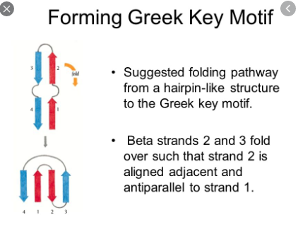

Slide 12
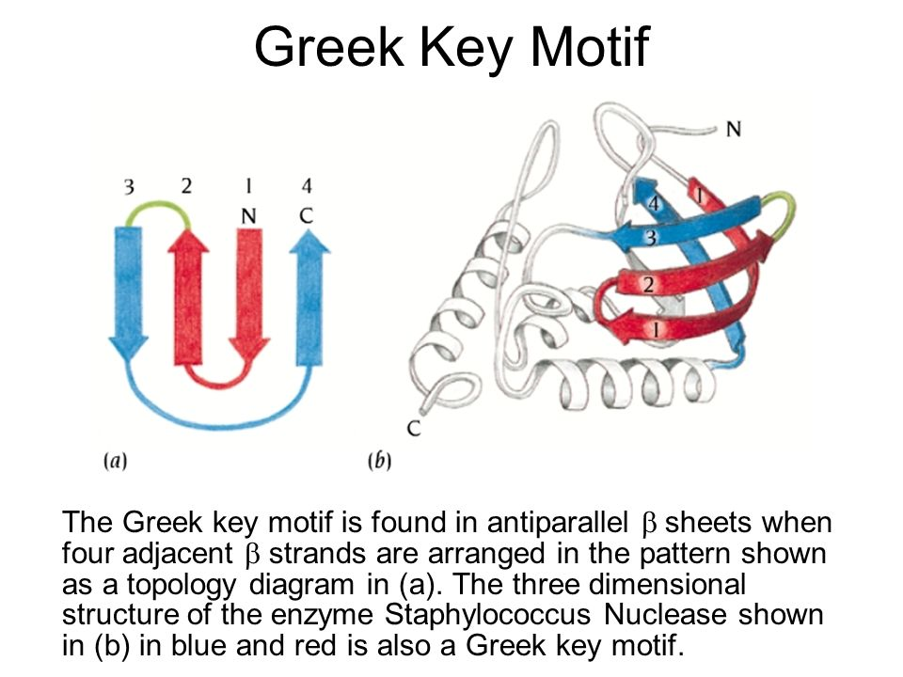

Slide 13
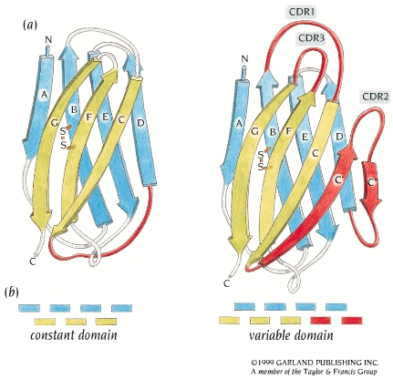
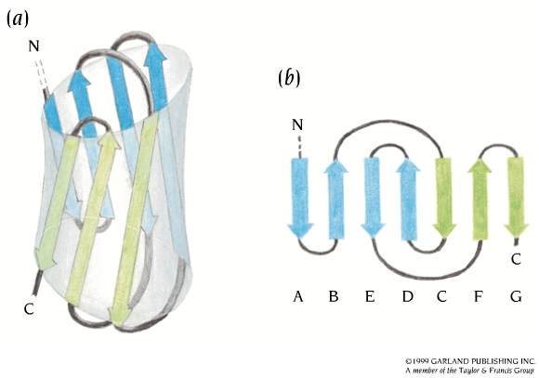
The Fold of IgG Domains
Beta strands labeled A-G of the constant and variable domains of immunoglobulins have the same topology and similar structures. There are two extra β strands, C' and C'' (red) in the variable domain. The loop between these strands contains the hyper-variable region CDR2. The remaining CDR regions are at the same end of the barrel in the loops connecting β strands B and C and strands F and G.

Slide 14
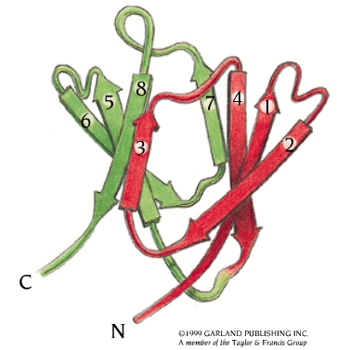
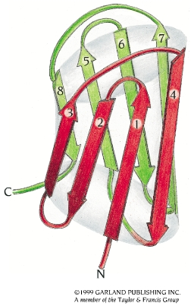
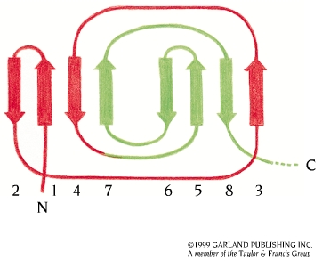
Gamma Crystallin Domain
The domain structure of γ-crystallin is built up from two β sheets of four antiparallel β strands, sheet 1 from β strands 1, 2, 4, and 7 and sheet 2 from strands 3, 5, 6, and 8.
It is obvious that the β strands are arranged in two Greek key motifs, one (red) formed by strands 1 - 4 and the other (green) by strands 5 - 8.

Slide 15
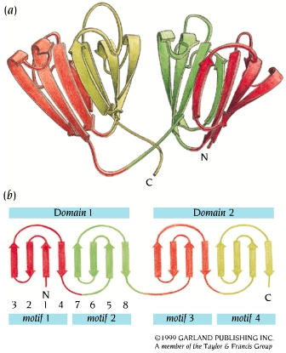
Complete γ-crystallin Molecule
The two domains of the complete molecule have the same topology; each is composed of two Greek key motifs that are joined by a short loop region.
There is a greater amino acid sequence homology between the domains than the motifs within each domain, suggesting that the four Greek Key motifs in γ-crystallin are evolutionarily related by gene duplication and fusion.

Slide 16
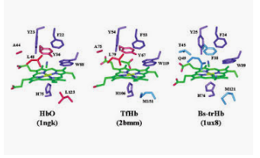
Work Sheet

